Slide 1

Climate Change and Wildfire Activity
Rozita J. Farahani

Slide 2
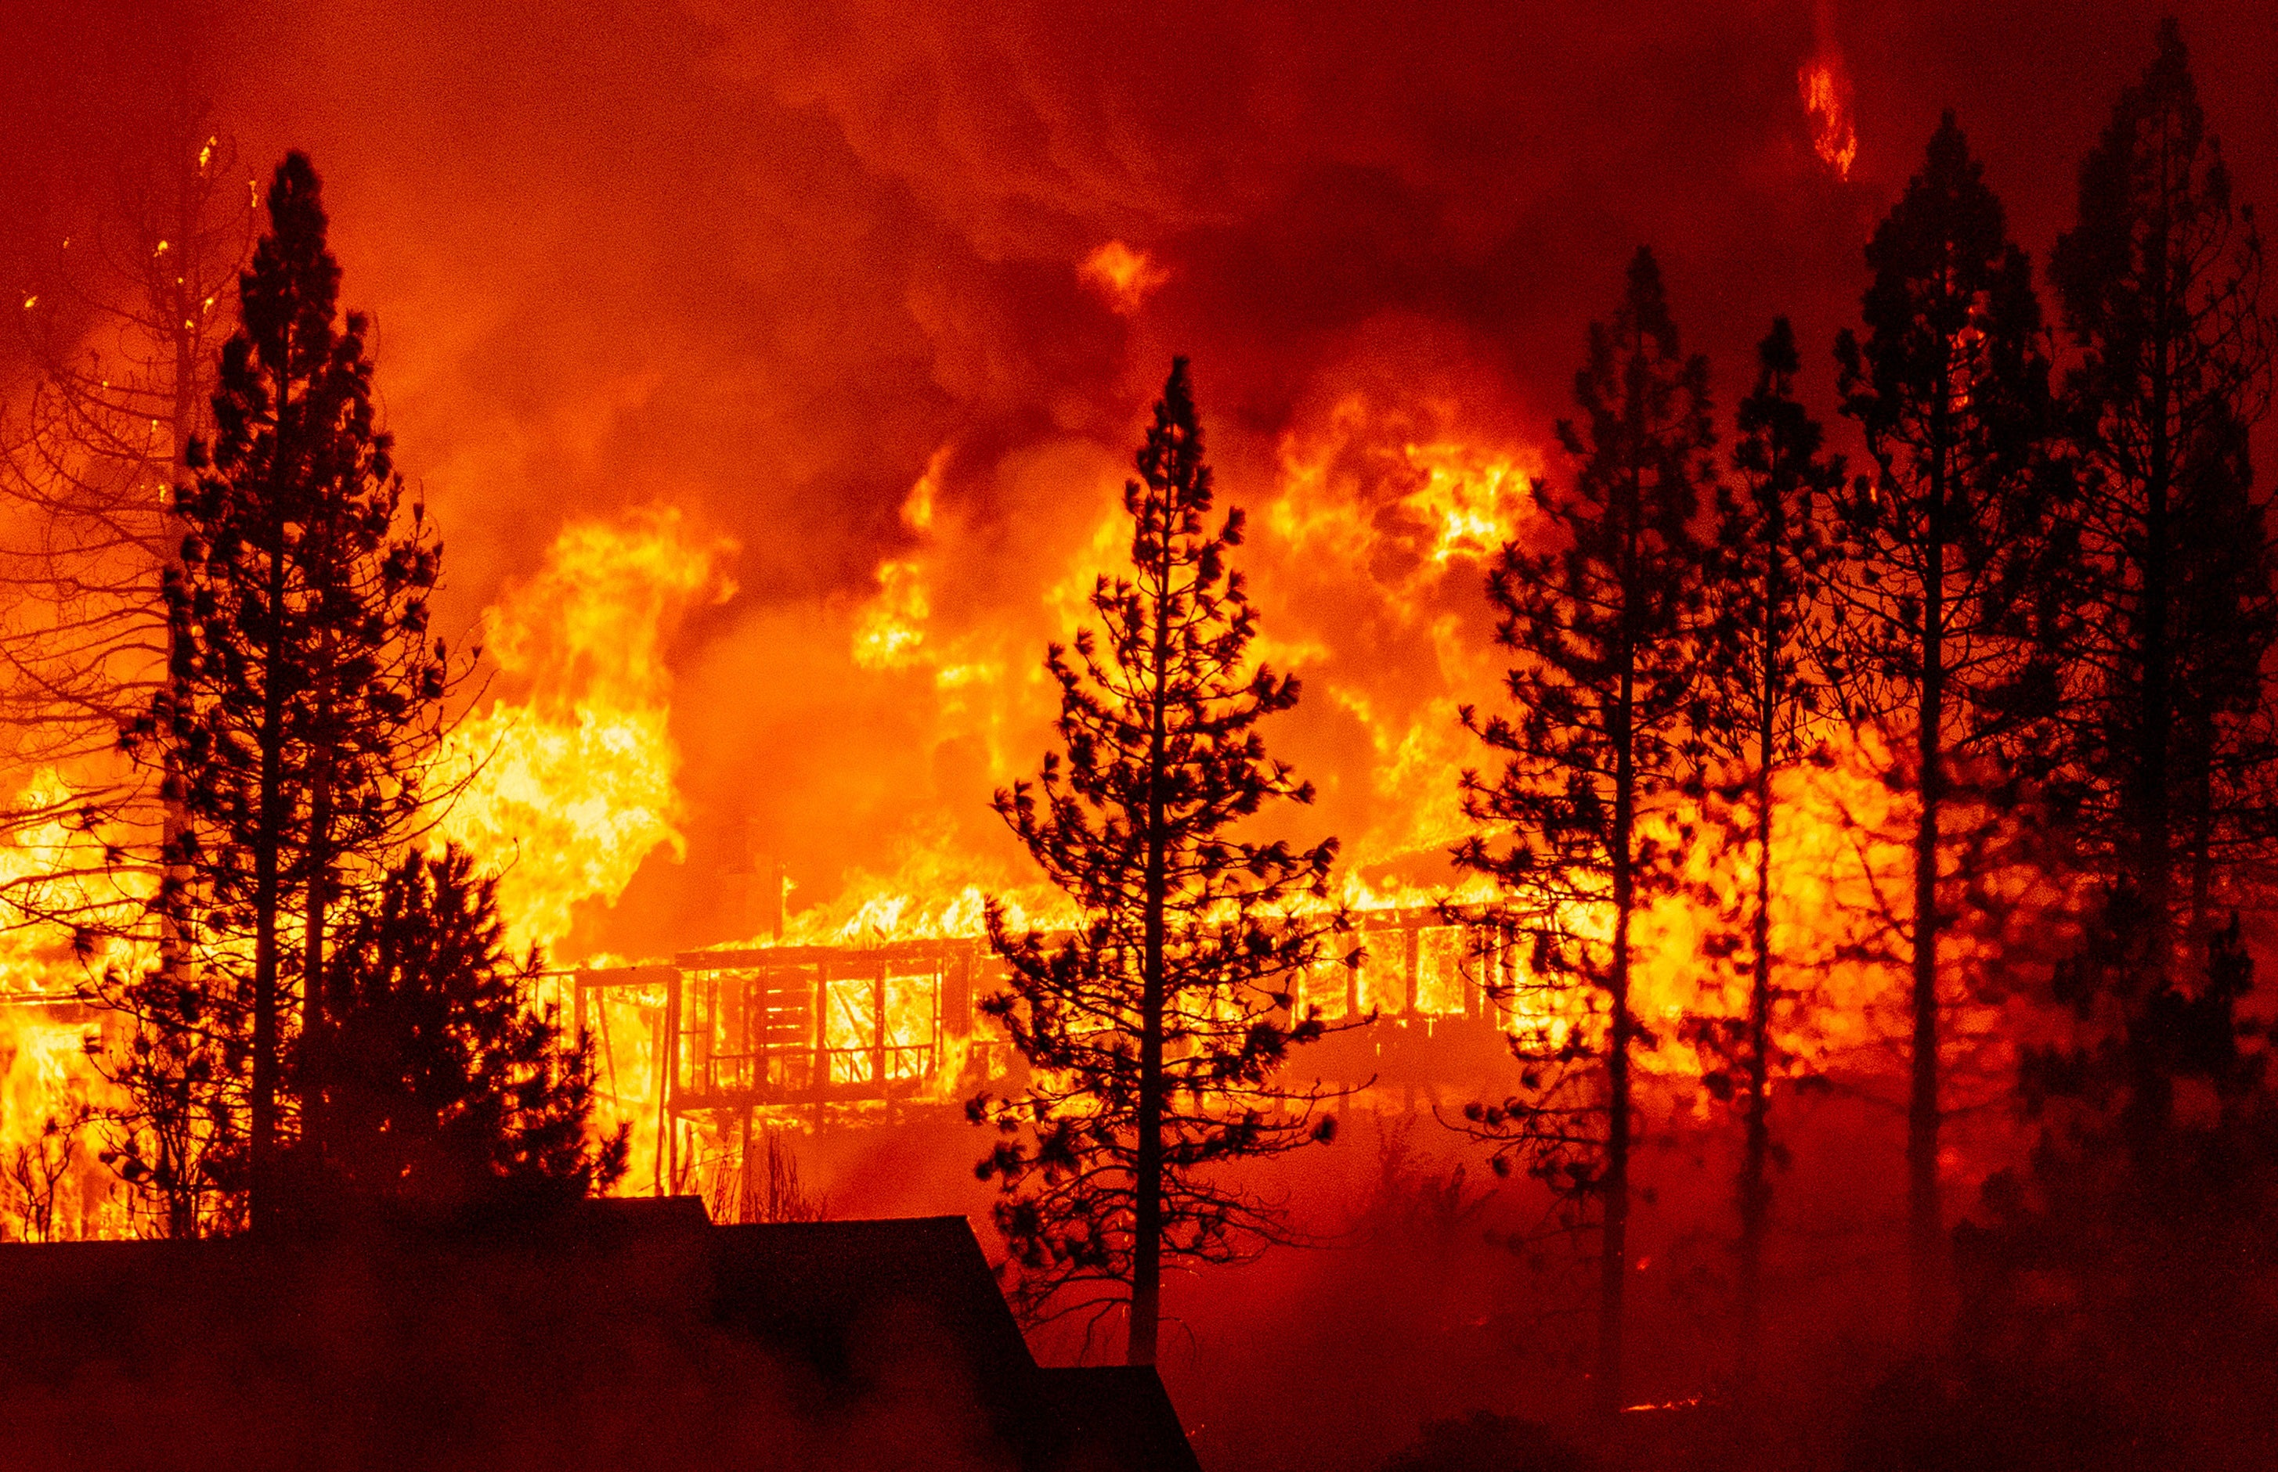
Motivation
Wildfires have consumed increasing areas of western US forests in recent years.
Fire fighting expenditures by federal agencies now exceed US$1 billion/year
Hundreds of homes are burned
annually by wildfires, and damages
to natural resources can be extreme
and irreversible

Slide 3
Who is the project useful for?
Wildfire Risk analysis could be used for different organizations. For example:
Federal organizations preparing rescue planning and warning systems.
Insurance companies planning to spread their risks.
Tourism industry

Slide 4
Data - Climate
Land and ocean temperature provided by Berkeley Earth
Monthly average/max/min temperature from 1743 to 2020. The data set covers the globe.

Slide 5
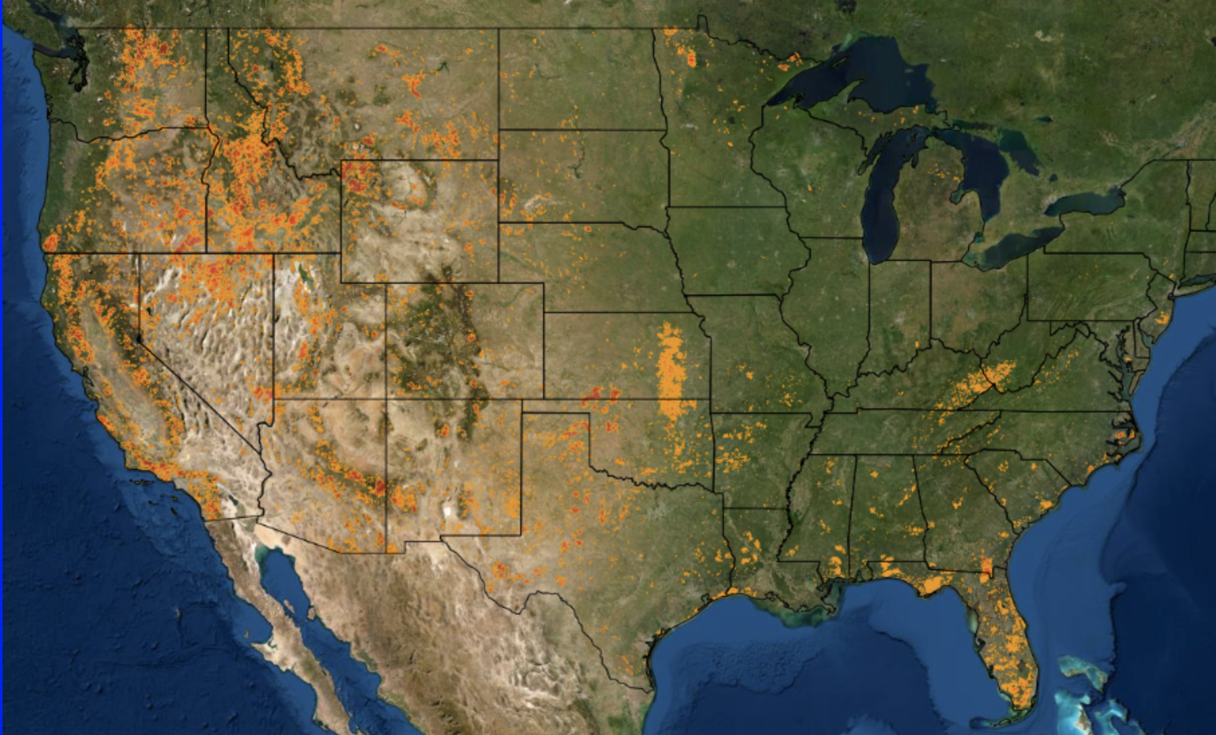
Data - Fire
35 years of fire history data provided by MTBS (1984-2019)
The data covers continental USA, Hawaii, Alaska, Puerto Rico
It includes Location (Longitude, Latitude) , Ignition date, Area burned and Burn Severity

Slide 6
Project plan

